Slide 1
GENERAL BIOLOGY 11
BLY121

Slide 2

SIMILARITIES AND DIFFERENCES IN EXTERNAL FEATURES OF PLANTS AND ANIMALS

Slide 3

External features of living organisms especially animals are important because they are the details that we see therefore helps in their classification.

Slide 4

Arrangement of cells
Body symmetry
Nature of coelom
Patterns of digestive system
Circulatory or reproductive systems

Slide 5


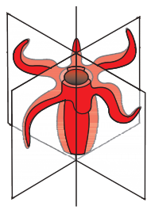
When any plane passing through the central axis of the body divides the organism into two identical halves, it is called radial symmetry. Coelenterates and echinoderms have this kind of body plan.

Slide 6
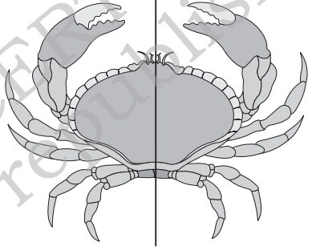
when body is divided into identical left and right halves in only one plane, it is termed bilateral symmetry.

Slide 7

In some animals, the body is externally and internally divided into segments with a serial repetition of at least some organs. For example, in earthworm, the body shows this pattern called metameric segmentation and the phenomenon is known as metamerism.
Arthropods also exhibit segmentation.

Slide 8

Protozoans → Porifera →Coelenterata→ Platymelminthes→ Nematoda→ Annelida→ Arthropoda→ Mollusca → Echinodermata → Chordata

Slide 9

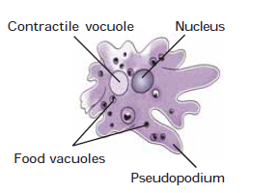
Body shape is irregular with many blunt pseudopodia
A contractile vacuole and several food vacuoles are
present in the cytoplasm
Amoeba
Amoeba

Slide 10
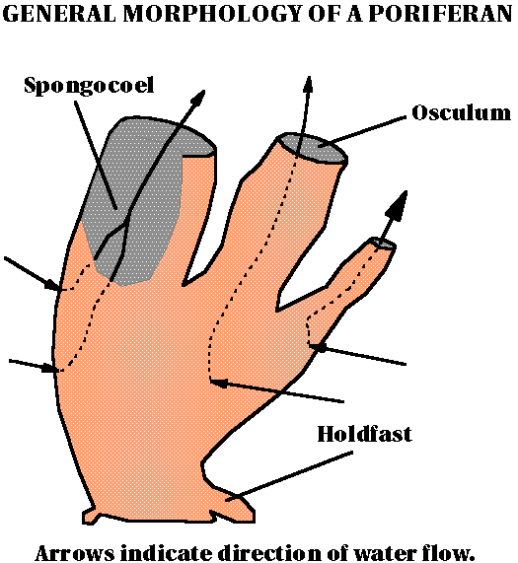
Sponges are the most primitive of the modern animals. They represent a level of organization somewhere between a colony of cells and true multicellular organisms
They are regarded as evolutionary dead end
Amoeba
Sponges

Slide 11

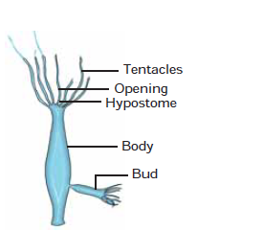
Body, called polyp is elongated and cylindrical.
Long, slender and contractile tentacles (6-10) are present that encircle hypostome with an opening at the tip. This end is called oral end.
The opposite (aboral) end of the body is flat, which helps the animal to attach itself to the substratum. This is called
basal disc.
Bud-like structures branch out from the polyp, which
ultimately separate as young hydra (vegetative propagation).
Sometimes, gonads may be seen as small bulges on the body.
Hydra

Slide 12

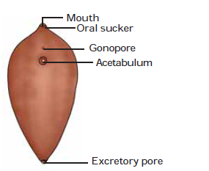
A leaf-like dorso-ventrally flattened body , about
20-30 mm in length, and 4 to 12 mm in width in the middle.
Mouth is present at the tip of the cone, and is surrounded
by a muscular oral sucker
Fasciola (LIVER FLUKE)

Slide 13
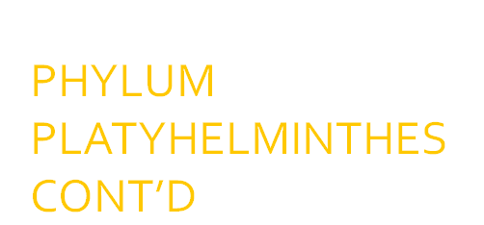
Slightly anterior to acetabulum on the ventral surface, there
is an opening called genital aperture or gonopore.
Anterior part of the body is broader with a conical end
At the tip of the posterior end, an opening called excretory
pore is present.
Fasciola (LIVER FLUKE)

Slide 14
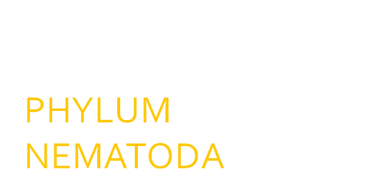
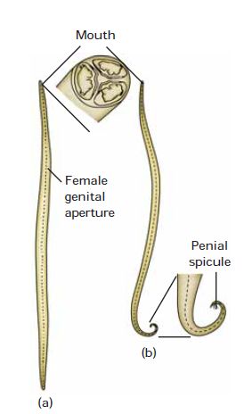
Body long (20 to 40 cm), cylindrical (5 to 6 mm
diameter) with no segmentation.
Both the ends are pointed; posterior end of male is
ventrally curved.
Excretory pore is present on the ventral surface slightly
behind anterior end.
Ascaris (round worm) (a) Female (b) Male

Slide 15
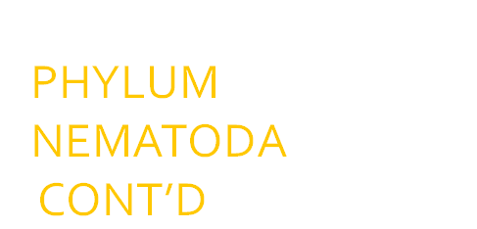
Mouth is situated at the anterior end, and is surrounded
by three lips.
The female genital aperture is present mid ventrally at about one-third distance from
the anterior end
Ascaris (round worm) (a) Female (b) Male

Slide 16
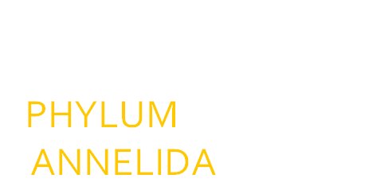
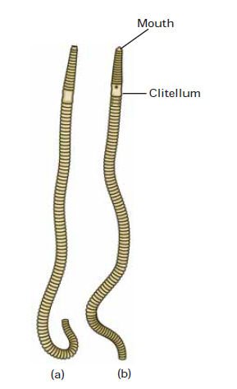
Entire body is divisible into more than 100
externally distinct segments of almost equal size.
These segments are called metameres.
Body surface of the living animal is slimy and moist
due to the secretion of mucus from the body wall.
Pheretima (Earthworm) (a) Dorsal view (b) Ventral view

Slide 17
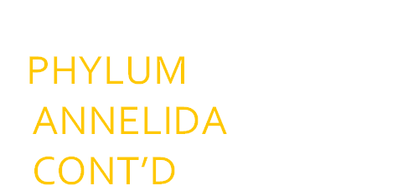
Dorsal and ventral surfaces of the body can be easily
distinguished, as the dorsal surface is darker than
the ventral side.
In the adult earthworm, the skin or body wall around
the segments 14th to 16th is comparatively thick,and it is called clitellum
Pheretima (Earthworm) (a) Dorsal view (b) Ventral view

Slide 18
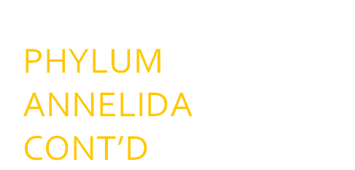
Mouth is situated ventrally in the first metamere called the peristomium.
Anus is situated at the tip of the last metamere.
Pheretima (Earthworm) (a) Dorsal view (b) Ventral view

Slide 19

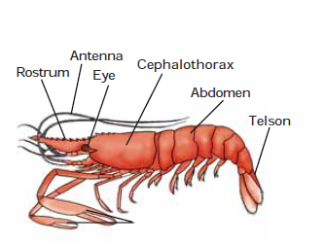
Body is apparently
divided into anterior
cephalothorax (fused head and thorax) and posterior abdomen.
The cephalothorax can be identified by a thick and hard shield- like cover, called the carapace.
A pair of stalked compound eyes are present.
Palaemon (PRAWN)

Slide 20
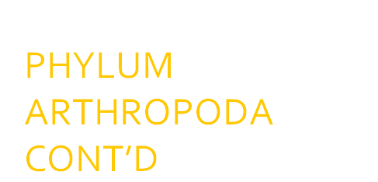
Abdomen consists of six segments each with its own set of biramous appendage.
Animal size variable it measures between 20 & 30 cm in length.
Usually orange-red in colour, however, the colour is variable.
Body is elongated, bilateral
and symmetrical.
Palaemon (PRAWN)

Slide 21

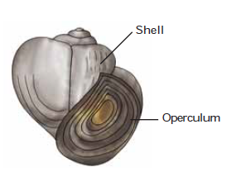
Body of the animal remains lodged within a
hard and one-piece spirally coiled calcareous
shell
There is a wide opening at the end of the last
whorl of the shell, which remains closed by
another calcareous plate called operculum.
The body consists of four regions: head, foot,
visceral mass and mantle.
It inhabits shallow freshwater (paddy fields,
ponds) and moves with its foot.
Pila globosa

Slide 22

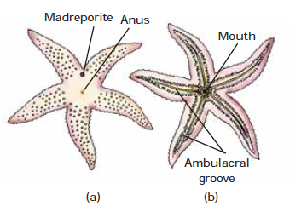
Starfish is a unique
marine organism, which can be identified by its star-shaped pentamerous
structure
Body with apparent radial symmetry with diameter ranging between 15-20 cm.
Asterias Star fish (a) Aboral view (b) Oral view

Slide 23
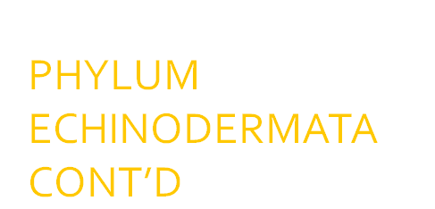
Radiating from the mouth there are five grooves, the ambulacral grooves, which continue in the five arms on the oral side.
Special organs, called tube feet, are present in these ambulacral grooves.
Body has a central disc from which five tapering arms radiat
Asterias Star fish (a) Aboral view (b) Oral view

Slide 24
The upper surface is called aboral surface, where anus is present
At the margin of the central disc on the aboral surface is a circular sieve like structure called madreporite situated near the junction of
two arms.
Asterias Star fish (a) Aboral view (b) Oral view

Slide 25
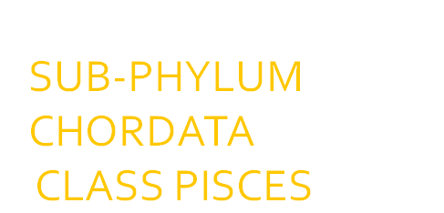
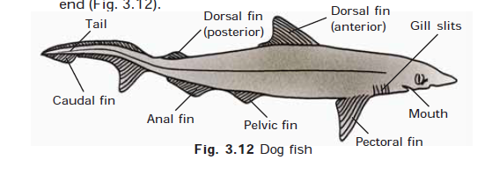
Body measures up to 60 cm in length.
Body is covered with minute placoid scales that can be felt when skin
is rubbed from tail to snout.
Body is divided into head, trunk and tail.
A mouth is present on the ventral surface of the head
behind the tip.
Scoliodon

Slide 26
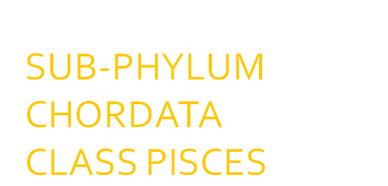
Mouth has several rows of sharp and backwardly pointed teeth on both upper and lower jaws.
Tail is elongated with heterocercal caudal fin.

Slide 27
Body bears a number of unpaired and paired fins. The unpaired fins have two dorsals, a lobed caudal and a median ventral fin. Pectoral
and pelvic fins are in pairs.
Five pairs of gill slits are present laterally between mouth and
pectoral fins.

Slide 28
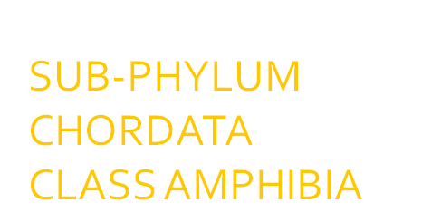
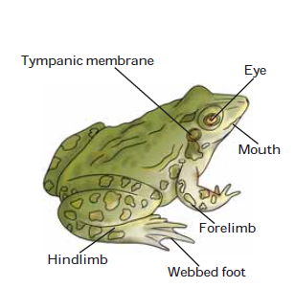
The body consists of head and trunk, neck is absent.
Skin is naked, (that is without any type of scales) and slimy (secretion of mucous glands present in
the skin).
Rana tigrina (frog)

Slide 29
Mouth is terminal, having protrusible bifid tongue.
Upper jaw is beset with several rows of spiny teeth, lower jaw has no teeth.
Forelimbs are smaller than the hindlimbs. The
forelimbs have four, and hindlimbs have 5 clawless digits.
Rana tigrina (frog)

Slide 30
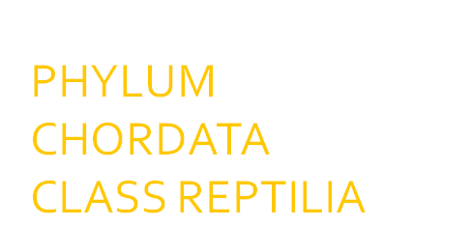
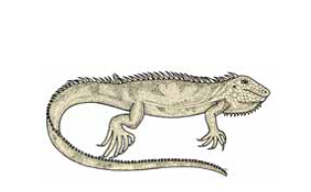
Body is divided into head, neck, trunk and elongated tail.
Body is coveredwith rough epidermal
scales
Head is triangular with a cone-shaped snout having a wide mouth. A pair of nostrils and eyes
present on the head. Eyes are in position on head.
Calotes (Garden lizard)

Slide 31
Two pairs of pentadactyl (five digits) limbs; the
digits are clawed.
The skin provides the animal with protective colouration in its environment
Calotes (Garden lizard)

Slide 32
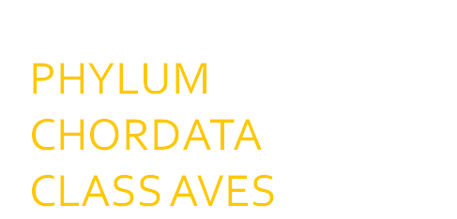
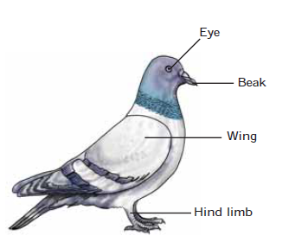
Body covered with feathers.
Streamlined body divisible into head, neck and trunk.
A small and round head, having beak without teeth. In addition the head bears a pair of nostrils,large eyes and opening of the ears (covered
with feathers).
Columba livea (Pigeon)

Slide 33
Eyes are provided with movable eyelids and nictitating membrane.
Cylindrical neck is very flexible to facilitate mobility of the head.
Forelimbs are modified into two wings for flying.
Columba livea (Pigeon)

Slide 34
The hindlimbs have
four-clawed digits of which the first one is backwardly directed and the
remaining three are forwardly directed. It helps in perching and bears
the weight of the body while standing.
Columba livea (Pigeon)

Slide 35
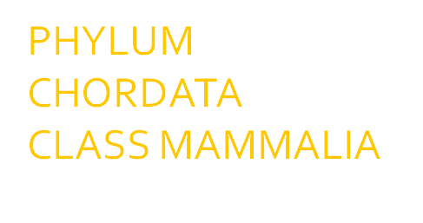
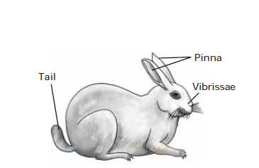
A medium sized animal, about 40 cm in length when adult.
Body is covered with hair, and is divisible into head, neck,trunk and a small tail.
A short but highly flexible neck is present between the head and the trunk.
Oryctolagus lagomorpha (Rabbit

Slide 36
Males have a small, cylindrical and muscular penis, a pair of scrotal sacs in which a pair of testes are lodged.
Females have slit-like vulva. Females also have four to five pairs of mammary glands, which open ventrally as teats or nipples along the thorax and abdomen.
Oryctolagus lagomorpha (Rabbit

Slide 37
Animal is viviparous.
Tail is short, upwardly directed and furry.
Oryctolagus lagomorpha (Rabbit

Slide 38

PLANTS DIVERSITY AND EXTERNAL STRUCTURE
Plants are multicellular photosynthetic organisms adapted for life on land.
In order to be adapted to life on land, they are differentiated into a holdfast and an upper photosynthetic area.
They developed features such as fatty coating, the cuticle, that covers the above ground parts of the plant body preventing water evaporation; and stomata, specialized openings in leaves and green stems through which CO₂ enters and O₂ exits.
Plants have a reproductive cycle that involves alternation of generations.

Slide 39
PLANTS DIVERSITY AND EXTERNAL STRUCTURE
Flowerless and seedless plants are lower and more primitive plants forming 3 main groups:
Thallophyta: This includes algae, fungi, bacteria and lichens
Bryophyta: This includes liverworts, horned liverworts and mosses
Pteridophyta: This include ferns

Slide 40

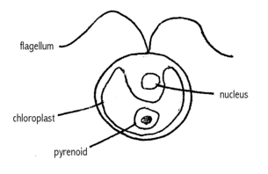
Algae: These are green thallophytes that contains chlorophyll.
The body of an alga is composed of a true parenchymatous tissue and its cell wall is made up of true cellulose.
Algae live in water or in wet substrata
Chlamydomonas

Slide 41

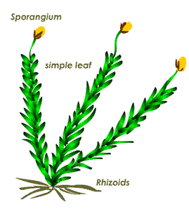
A moss plant
Stems radial symmetry (mosses)
Stems in liverworts exhibits bilateral symmetry, no lignin
No true leaves or roots
No cuticle
Reproductive structures are called sporangia which are on long stalks with capsules on end.
A moss plant

Slide 42

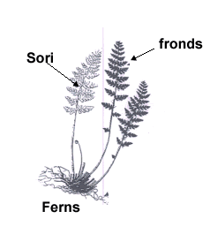
Possess true leaves
Possess roots and stems are not woody.
Height up to 20m
Sporangia (sori) contain reproductive spores
Fern

Slide 43

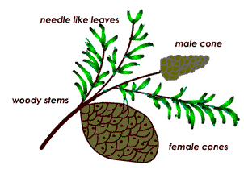
Trees (100m), shrubs,
Woody (lignin) stems,
Waxy narrow needle like leaves.
Vascular system (tracheids)
Reproduction: Monoecious, microsporophylls (male) non motile gametes often with air bladders for water/ air dispersal. macrosporophylls (female) ovule on cone scale
Conifer plant, an example of the gymnosperm
Conifer plant, an example of the gymnosperm

Slide 44
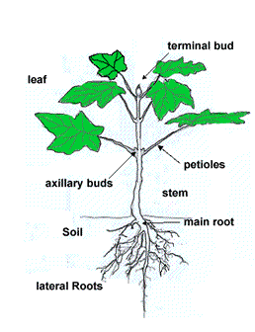
They have true leaves, stems and roots.
They have vascular bundles (xylem/ phloem) .
Possess waxy cuticles.
They are annual or perennial plants and are up to 100m in height.
Angiosperm plant

